Slide 1
Working with REST API and Python SHOAIB AKHTAR

Slide 2
Agenda
REST API Introduction
Why REST API?
Understanding HTTP
Requests Module – Making a GET request
Requests Module – Making a POST request
Workflow with WMS

Slide 3
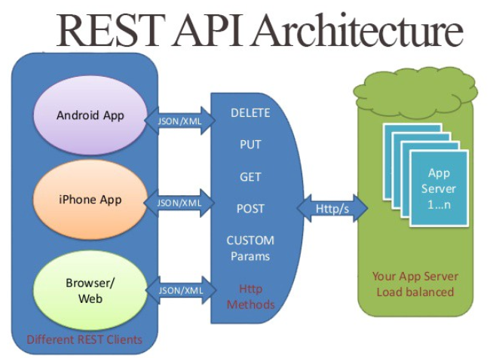
Introduction
Rest-API
REST is a web standards based architecture and uses HTTP Protocol for data communication. REST is a way of managing the client-server relationship and strives for speed and performance by incorporating re-usable components
By using a stateless protocol and standard operations, REST systems aim for fast performance

Slide 4
Why Rest-API automation required?
Product Stability : Product where there is a constant development happening while UI elements are changing in regular build, developing UI Automation for complete suite will lead more unstable automation products.
Test for Core Functionality : Testing the core, code-level functionality of the application provides an early evaluation of its overall build strength before running GUI tests.
Reduce testing cost : API test automation provides better, faster test coverage than automated GUI tests. The end result of faster testing is a reduced overall testing cost.
Low Maintenance : Since REST APIs resides below UI layer, helps improve accuracy as well as stability of the design.
Products like WMS , WDM and CGS uses rest-api as a functional level, will have more impact using REST API Framework

Slide 5
Understanding HTTP
What is HTTP? HTTP is a set of protocols designed to enable communication between clients and servers. It works as a request-response protocol between a client and server. A web browser may be the client, and an application on a computer that hosts a web site may be the server.
So, to request a response from the server, there are mainly two methods:
GET : to request data from the server.
POST : to submit data to be processed to the server.
Now, to make HTTP requests in python, we can use several HTTP libraries like : httplib, urllib and requests
Arrays of object references

Slide 6
requests Module – Making a GET request
# importing the requests library
import requests
# api-endpoint
URL = "http://maps.googleapis.com/maps/api/geocode/json"
# location given here
location = "delhi technological university"
# defining a params dict for the parameters to be sent to the API
PARAMS = {'address':location}
# sending get request and saving the response as response object
r = requests.get(url = URL, params = PARAMS)
# extracting data in json format
data = r.json()
Arrays of object references

Slide 7
requests Module – Making a POST request
# importing the requests library
import requests
# defining the api-endpoint
API_ENDPOINT = "http://pastebin.com/api/api_post.php"
# your API key here
API_KEY = "XXXXXXXXXXXXXXXXX"
# data to be sent to api
data = {'api_dev_key':API_KEY,
'api_option':'paste',
'api_paste_format':'python'}
r = requests.post(url = API_ENDPOINT, data = data)
Arrays of object references

Slide 8
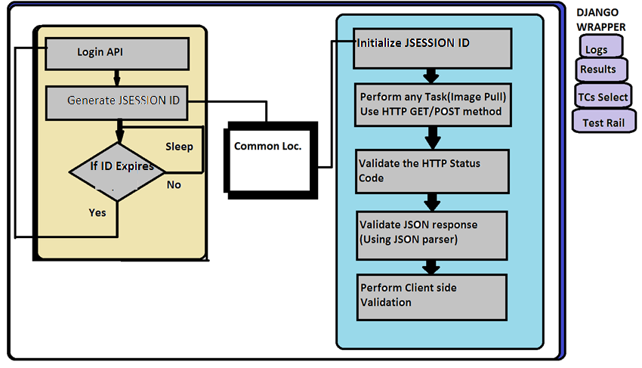
Work flow (with WMS as Sample)

Slide 9
Thank you

